Slide 1

Healthwatch Sandwell Annual Public Meeting
16th August 2022
Agenda
Overview & Last Years Achievements
Phil Griffin, Healthwatch Sandwell Chair
Healthwatch Sandwell highlights of our Annual Report
Alexia Farmer Healthwatch Manager & Staff Team
Sandwell Place Based Partnership
Daren Fradgley – Chief Integration Officer,
Tammy Davies – Group Director, Primary Care, SWBH NHS Trust
Black Country Star Project
Sarah Offley, Chief Officer, Dudley Voices for Choice

Slide 2
Meeting Etiquette & Introduction
Phil Griffin - Healthwatch Sandwell Advisory Board Chair

Slide 3





Virtual meeting etiquette
Please mute yourself unless you wish to speak
Turn on gallery view if you want to see more people
If you want to say something click the “reactions” icon and select raise hand
You could also use the chat function to comment or ask a question

Slide 4
Our Annual Report Highlights
Championing What Matters to You

Slide 5
Report Highlights – Alexia Farmer, Healthwatch Sandwell Manager
Reaching out
People share their experiences through a wide range of ways such as outreach, focus groups, surveys.
Making a difference to care
We published 10 reports about the improvements people would like to see to health and social care services.

Slide 6
Report Highlights – Continued
Getting services to involve the public
Midland Metropolitan University Hospital
Supported patient and carer engagement on Sickle Cell and Thalassaemia services (which are transferring from City Hospital)
Contributed insight on patient and visitor way finding
Working with Public Health for better pharmacy access
Supported the pharmaceutical needs assessment (PNA) steering group
Access to dentistry in Sandwell
Volunteers undertook a mystery shopper activity of 45 Sandwell dentists to establish whether people can access full NHS dentistry services.

Slide 7
Sophie Shuttlewood, Projects & Partnerships Lead
Priority Projects 2021/22
The hidden impact of Covid-19 on Carers
“Patients in waiting” - experience of hospital treatment pathways

Slide 8



Partnerships with seldom heard groups –
Care Quality Commission project
The aim of the project was to hear from seldom heard communities about:
What they know about and what they can expect from Health and Social Care services in Sandwell
Their understanding of the role of the CQC and how the latter can engage with these communities.
We engaged with:
people who had experienced homelessness at some point in their life (survey with host families)
People who have Sickle Cell (inherited blood disorder) (virtual group meeting & telephone conversations)

Slide 9
Melissa Elders
Community Outreach Lead
Challenging through the pandemic – adapt and work differently however – opportunities opening up
3535 people have shared experiences with Healthwatch Sandwell.
291 came to us for clear covid advice and information about topics such as mental health and covid 19.
Engage throughout Sandwell and with its diverse population.

Slide 10
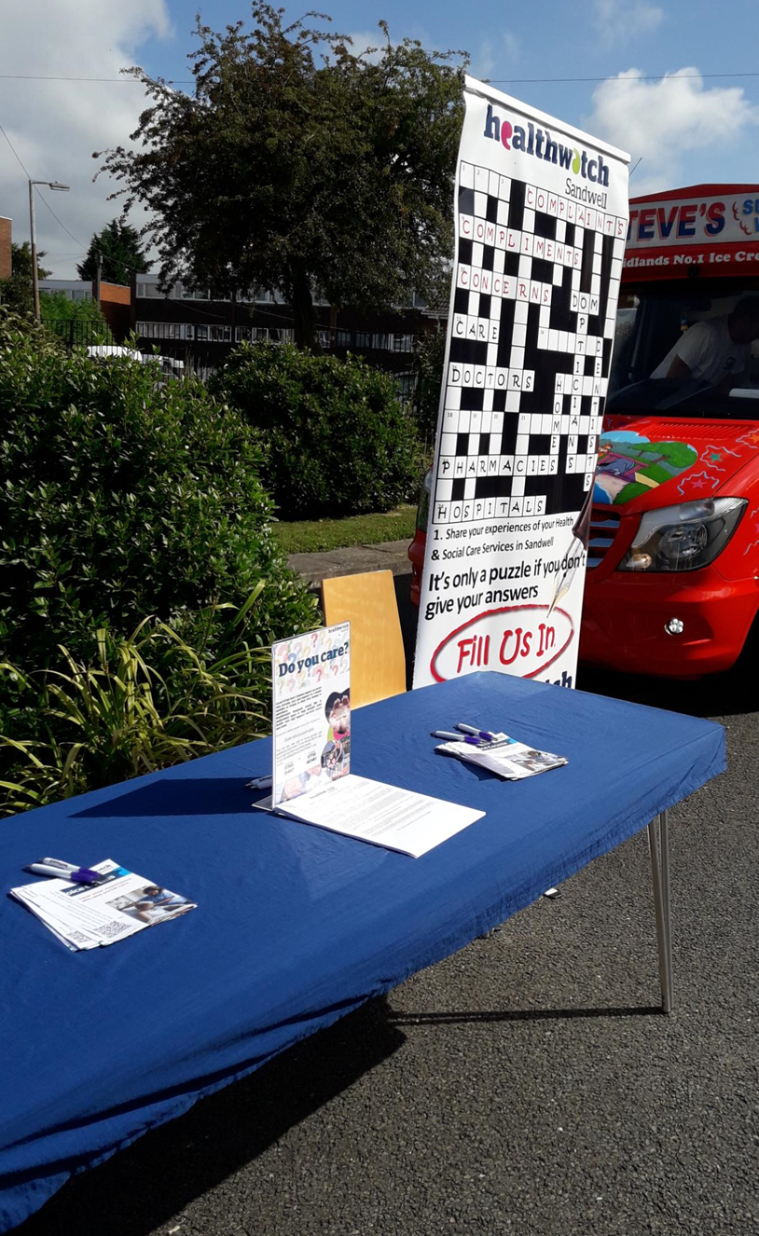
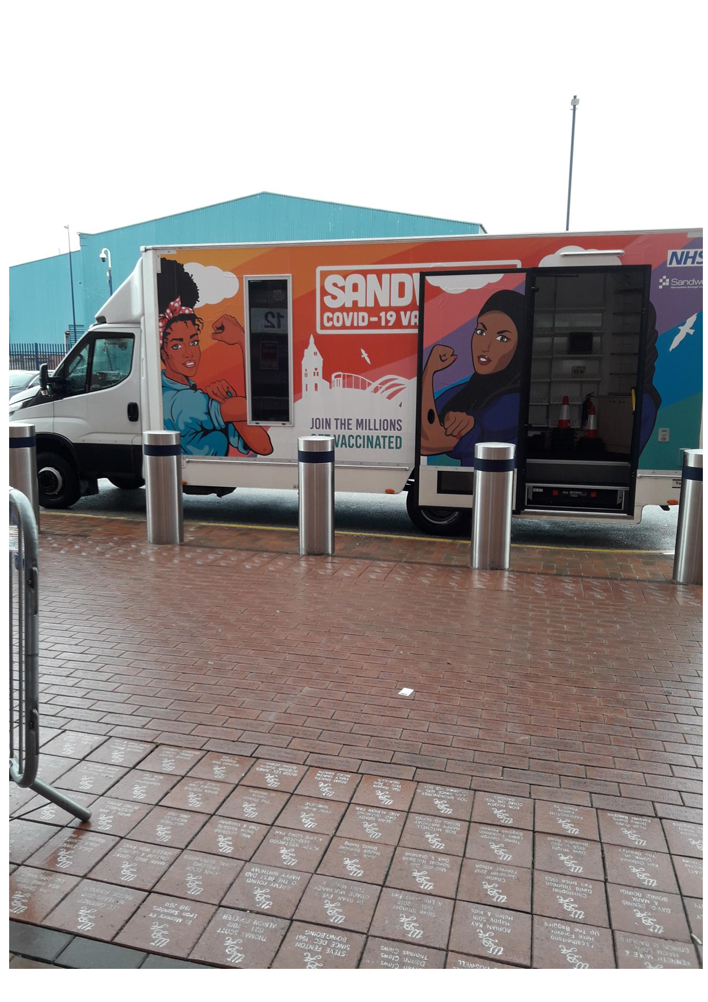
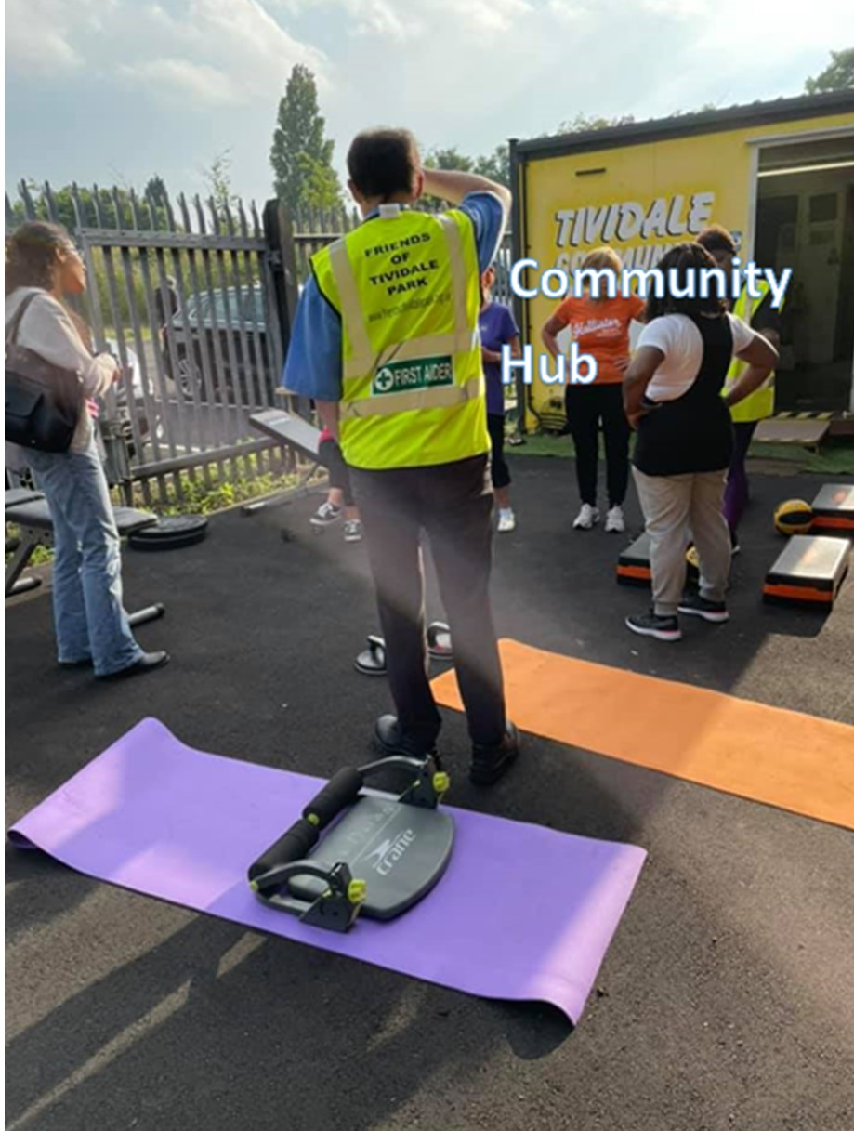
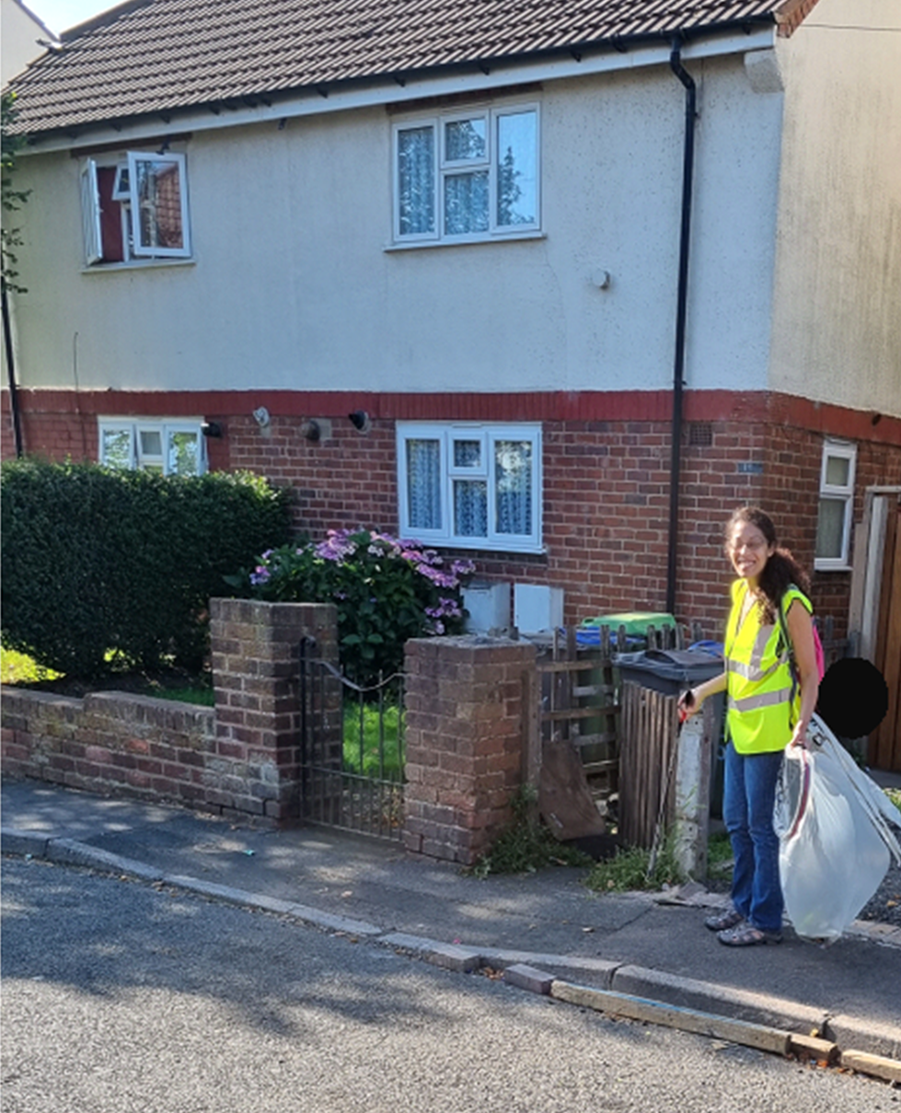
Outdoor fitness, Tividale Park
Litter picking with Litter Watch
Stepway Launch Event, Salvation Army
Vaccination site,
West Bromwich Albion

Slide 11
Anita Andrews – Engagement & Volunteer Lead
Volunteering with Healthwatch Sandwell
Range of activities
CAMHS Council
Community Outreach
Projects including administrative support
Enter and View visits
Notes:
Paul:
When you play the slide show, can you show the pie chart and I’ll talk to it?
Then show: Range of activities but click each activity as I speak….not all at once

Slide 12


What our volunteers say….
I can honestly say that I have enjoyed every second of the time I have committed to volunteering. Not only because it enables me to utilise and develop my existing skills, but it also helps me to learn new skills too!
I'm surrounded by friendly and ​welcoming volunteers who share similar ideas
I have to admit, this is by far the most enjoyable volunteering experience which I have accessed, and I am proud to be working towards improving the services that members of the community access daily.
Becoming a volunteer has made me more aware of the support systems within our community and the needs of different people.
For more information:
Anita Andrews | Engagement and Volunteer Lead
M| 07885 214421
Notes:
Paul
Can you show each speech bubble, one at a time, so I can speak to each one.
The click Volunteers Needed and then I’ll advertise then can you click my contact details ?

Slide 13
This Years Priorities for 2022 -23
The patient experience of accessing primary care services
Accessibility for patients – meeting information and communication needs
Exploring the impact of language barriers in health and care services
Engagement with patients, service users and citizens around support care pathway improvements – Sandwell Place Based Partnership

Slide 14


Slide 15
Any Questions

Slide 16
Introduction
Tammy Davies.
Sandwell Place Based Partnership

Slide 17

Sandwell
Healthwatch AGM
16th August 2022
Tammy Davies – Group Director -Primary Care, Community & Therapies
Daren Fradgley – Chief Integration Officer SWBH

Slide 18
Sandwell Place Partners
We are a set of partners working together to focus on the needs of the population rather than the individual objectives of partners and their organisations
Sandwell Council
  Adult Social Care (Provision & Commissioning)
  Public Health
  Children's Services including Children's Trust
  Housing
Black Country Healthcare NHS Foundation Trust
Black Country ICB
8 Primary Care Networks (PCNs)
Sandwell Council for Voluntary Sector Organisations (SCVO)
Sandwell and West Birmingham NHS Trust
Health Watch Sandwell
Rights & Equality Sandwell

Slide 19
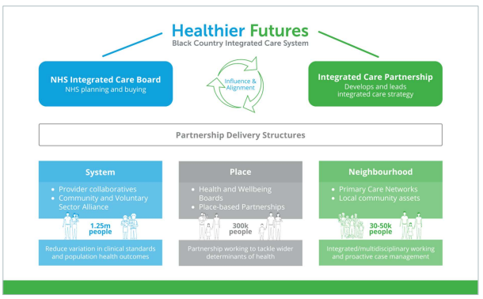
How Place fits into the system?

Slide 20

Place Based Partnerships – White Paper
Partners will take decisions together through a shared decision making model
Shared leadership and coordination roles
Pooling budgets and resources and reduce red tape
Oversight that will make local places truly accountable for delivery and decision making
Digital innovation across wider system areas to remove post code barriers
Workforce development and sharing
Focusing on the needs of the population rather than the objectives of the partners or the organisations

Slide 21
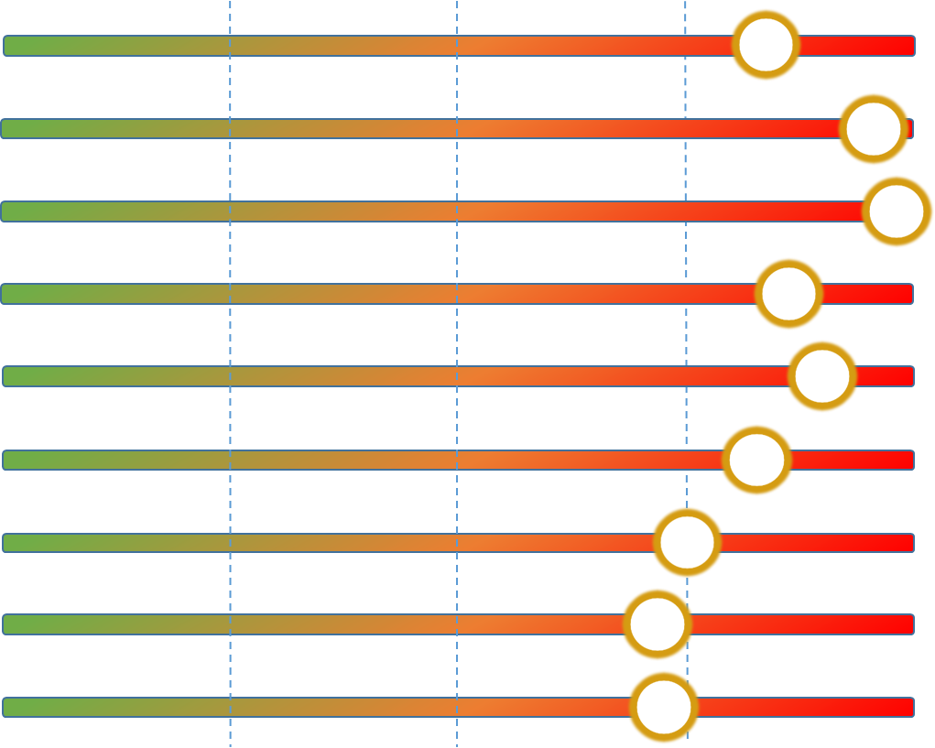
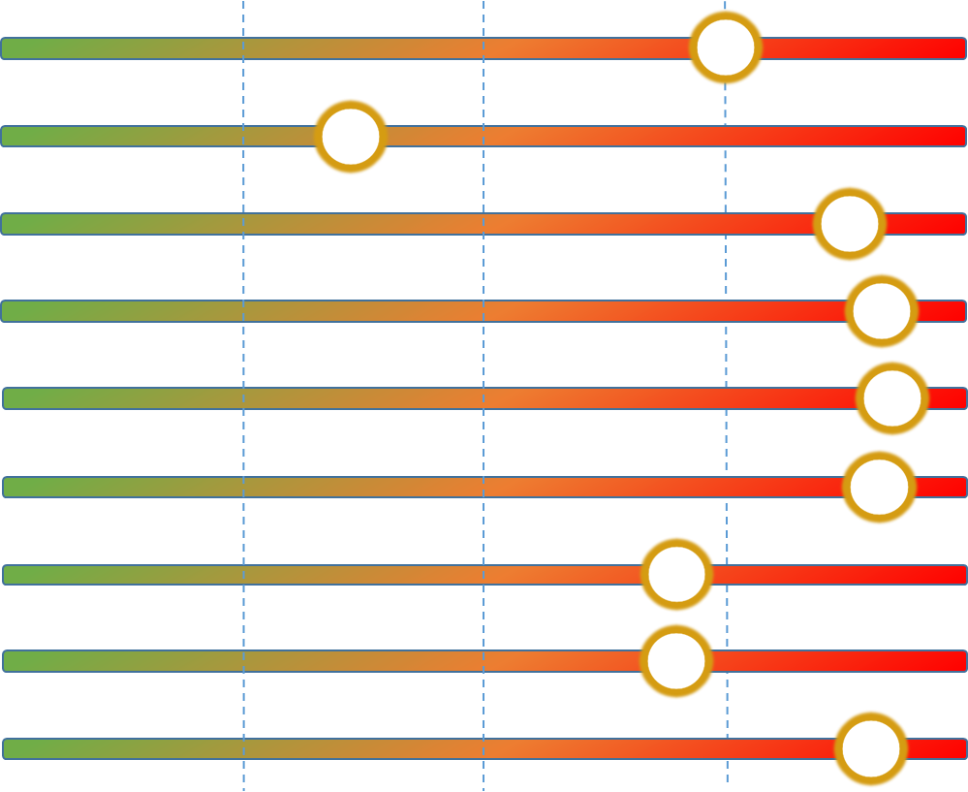
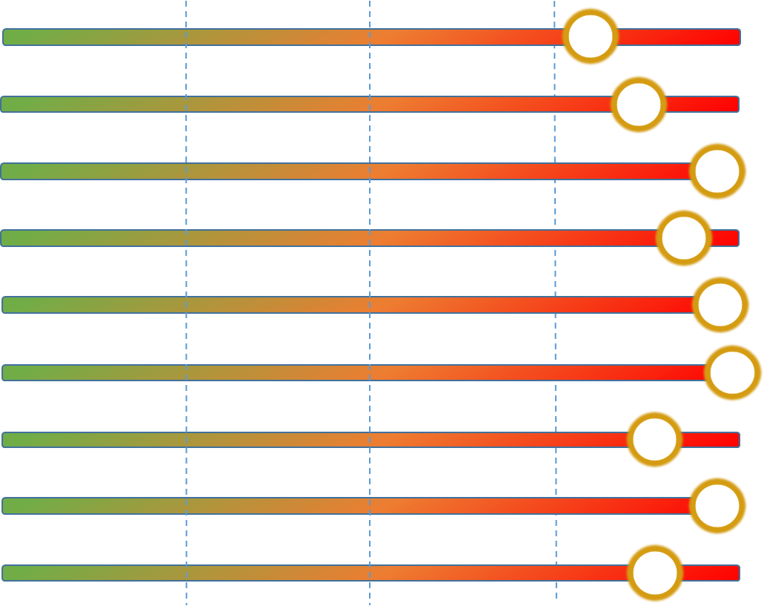
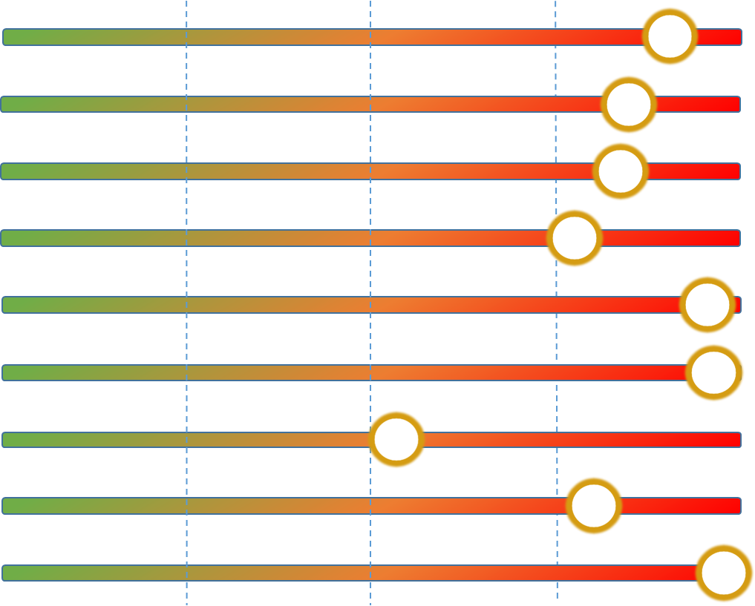
Health challenges
Dudley
Walsall
Healthy Life Expectancy
Healthy Life Expectancy
Index of multiple deprivation
Index of multiple deprivation
No Qualifications
No Qualifications
School Readiness
School Readiness
Yr 6 Obesity
Yr 6 Obesity
Adult Obesity
Adult Obesity
Economic Inactivity
Economic Inactivity
5 Fruit & Veg Day
5 Fruit & Veg Day
Physical Inactivity
Physical Inactivity
Wolverhampton
Sandwell
Healthy Life Expectancy
Healthy Life Expectancy
Index of multiple deprivation
Index of multiple deprivation
No Qualifications
No Qualifications
School Readiness
School Readiness
Yr 6 Obesity
Yr 6 Obesity
Adult Obesity
Adult Obesity
Economic Inactivity
Economic Inactivity
5 Fruit & Veg Day
5 Fruit & Veg Day
Physical Inactivity
Physical Inactivity
21
21
Notes:
All predictors have been arranged to the same polarity so red is worst and green best.
The bars depict centiles 1 to 100.
Predictors are arranged in order of influence in the model.
Arrows show trend.​

Slide 22
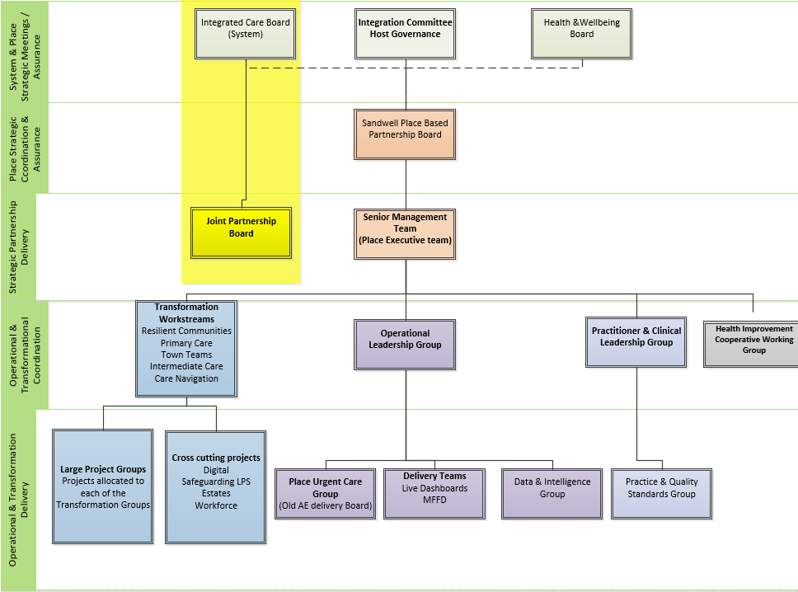

Slide 23
Resilient Communities
Lead Organisations
PCN’s
CCG
Integrated Town Teams
Care Navigation
Intermediate Care
Lead Organisations
SWB NHS Trust
Adult Social Care
Black Country HC NHS Trust
Lead Organisations
SWB NHS Trust
Adult Social Care
Black Country HC NHS Trust
Lead Organisations:
Adult Social Care
CCG
SWB NHS Trust
Approach & Benefits
Community and primary care providers working as a single team
Team managing a geography
Removal of referrals
Centres in each town
Remove provider duplication
Simplify the patients journey
Reduced demand on secondary care beds
Manage more activity with same resource
Primary Care
Approach & Benefits
Single team managing whole pathway
Remove the process of referrals
Manage long term care cost more effectively
Seamless citizen journey
Reduction in wasted acute and community bed days
More responsive to urgent care pressures
Reverse function to manage step up to prevent admission
Approach & Benefits
Single coordination point for partners
Capacity centre for the place
A true single point of access
Coordination centre for virtual wards and specialist outreach
Remote monitoring
Admission avoidance
Demand management
Approach & Benefits
Complete review of PC Access
Delivery of DES
Wider PC workforce not just General practice
Addressing access issues
Management of longer term conditions in collaboration with secondary care
Reduced referrals to other providers
Addressing overflow issues
Lead Organisations
Public Health
Housing
SCVO
Approach & Benefits
Citizens NOT patients
Strength based practice
Self care centric
Reduction Social Isolation
Aligning prevention services to needs
Reduced contacts in primary care & urgent care
Directly addressing wider determinants of health

Slide 24
Healthy Communities
Primary & Secondary Care Interface
Integrated Town Teams
Care Navigation
Intermediate Care
Virtual wards
Co location of teams
Step Up / Step Down / Rehabilitation
Single leadership structure
Alignment of known resources inc accommodation options
Coordination of activity
Demand and capacity MDT’s
Generic complex MDT’s
Condition specific MDT’s
Family Safeguarding
Care home in reach and management
Step Down support
Single referral processes – two way
Primary Care
DTA: Pathways 1 – 4
Intermediate care provision – Harvest View
Rowley and Leasowe beds
2 Hour Response
Mental Health
Single navigation function for
Professionals
999 / 111
Known service users
Virtual complex case management
Central demand and capacity overview
Ops centre
Advice and guidance for remote professionals
Virtual multi disciplinary teams
Demand Management
Workforce Planning
Restoration, Recovery & Re-imagination
Pathway development
Investigations
Data / Business Intelligence
PCN DES Oversight & Delivery
STAR Review
Single Handed Care
Digital
Integrated Discharge Hub
proactively supports high risk citizen supported by the use of population health data
Develop shared data and records
Mental Health
Mental Health
Drug Harm Reduction
Alcohol Harm Reduction
Smoking Cessation
Weight Management
and Physical Activity
Children’s Health
and Education
Housing and Environment
Social Isolation and
Community Development
Cross Cutting: Mental Health / Children’s / Estates / Digital / Safe Guarding / Workforce

Slide 25
Mental Health
Estates
Digital
Workforce
One Public Sector Estate approach
Joint Workforce Plan
Children’s
Assisted digital offer for the population
Community Transformation
Buildings for Co-location
Review H&WB Hub Locations
Hot Desk Facilities
Estate Reduction Programme
Future Options for Primary Care Estate
Future Employment offer for local people
Development of new roles
Development of career pathways
New ways of working
Organisational and culture development
Digital Access routes
Digital zones in community buildings
Shared Care Records
Place WIFI, File & Print Offer
Agile Working
Safe-guarding
Multi-Agency Shared Records
Comms & Engagement
Brand & Logo
Social Media Footprint inc Website Development
Stakeholder Engagement
Citizen Engagement
Stakeholder Newsletters
Shared Resource for delivery of LPS
Multi-Agency Case Discussions
Proactive support for “at risk” families and citizens
Training & Development
Children’s Emotional Health & Wellbeing
In-reach to Care Homes
Older Adult Therapy Services
Community Inclusion
Recovery College
Physical Health SMI
Rehabilitation
Complex Emotional Needs
Obesity
Asthma
Epilepsy
Diabetes
Infant Mortality
SEND
Early Health
Community Children's Services

Slide 26
An example journey The Integrated Discharge Hub (IDH)
Early example of a successful outcome when partners fully integrate
IDH formed in 2021 – working across the system with nursing, and therapy staff (SWBH) alongside colleagues from Adult Social Care and Sandwell CCG
Co-located single team working together to ensure the safe and timely discharge of patients from acute beds
Service then adopted the national Discharge to Assess (D2A) model which focuses on identifying patients’ likely discharge needs on admission thus avoiding unnecessary delays
People with care or therapy needs are discharged when medically appropriate and then assessed in their discharge destination

Slide 27
The Integrated Discharge Hub (IDH)
Team use trusted assessor approach – ensures contribution across the system rather than in silo ( reduces need for duplicated assessments)
Since the inception of IDH the length of stay for people in hospital beds following completion of their treatment has reduced considerably
Current average = 4.5days v 8.7 days ( 3 months ago)
More people receiving care in their OWN home with approx. 185pl at any one time now receiving intensive care and therapy at home compared to 90pl 12 months ago
The Partnerships has collectively invested in patients receiving rehabilitation at home rather than in a community bed with a collective ‘home first’ approach

Slide 28
Working with Sandwell Healthwatch
Healthwatch is an important place member
Worked successfully in other areas in partnership with HealthWatch organisation and look forward to continuing to establish this relationship here
Integral part of the Communications and Engagement workstream for place and will be a helpful sounding board and stress test approaches for benefit of Sandwell and its citizens
Help shape Place decision going forward with a citizen voice

Slide 30
Introduction
Sarah Offley, Chief Officer,
Dudley Voices for Choice
Black Country Star Project

Slide 31



LD & Autism Champion Plan 2021
What we’ll do
We will support the setting up of the BCH Star network which will measure the activity and guide health professionals on what people with learning disabilities and autistic people need and most importantly expect from their health services.
The BCH Star network puts the ‘patient’ at the forefront and empowers them to be in control of how interactions happen and how services will support them as individuals.
Our offer would be to support each local Healthwatch to grow and develop a peer group of peers with learning disabilities and autistic people to monitor the scheme.
How we’ll do it
By showing and sharing the BCH Stars network with each local Healthwatch, supporting them to set up the peer network by signposting to local groups, making information clear for all and delivering bespoke training in partnership with AWM to all the Healthwatch team that will be involved in the peer network. When the peer network is set up, hold regular sessions with the peers to gather and share their work strategically with both the LDA board and the ICS board.
How we’ll know if we’ve made a
difference
People led services with those that have the most experience guiding their own health care from a proactive stance making services better for themselves and their peers.
In addition to the better standards of care and more efficient services that will be offered, services will be benefiting from less cancellations, more time and by working in a preventative manner, a real improvement in relationships and trust for both parties.
Healthwatch will benefit from bespoke training from peers and by hosting the peer network will gain valuable insights into what it is like to live with a learning disability/autism.

Slide 32
What is the
Black Country Health Star Strategy?
Creating and equitable health care service for people with a learning disability – making necessary reasonable adjustments on an individual basis person centered way.
A trusting relationship in the knowledge that people with learning disabilities and autistic people know they will receive good care where they see the star.

Slide 33
Drivers for the Black Country Health Star Network
(LeDeR) – Learning Disability Mortality Review (2017) People with Learning Disabilities are dying considerably younger than the general population.
PWLD are dying on average 26 years younger (23 years for Men, 29 years for Women)
(CIPOLD) 48% deaths deemed avoidable (24% rest of population)
MENCAP’S Death by Indifference (2007) & 74 deaths and Counting (2012)

Slide 34
The Criteria For Black Country Health Star Accreditation for Health services
Learning Disability Champion/Autism Champions
Do you have a Learning Disability/Autism Champion in your practice? Do they interlink with the Carers Champion to ensure a holistic care approach is achieved and issues are identified early which may impact the health and wellbeing of the other?
Reasonable Adjustments / TEACH
Do all your staff from admin support to GP’s know about the legal requirement for reasonable adjustments and the impact they can have on health outcomes? We use the acronym TEACH to help embed this in everyone’s everyday practice.
Health Star Folder
Do you use and promote the use of the Health Star Folder? Are all your staff aware of it?
Accessible Environment
How accessible is your environment for people with learning disabilities and Autism? Do you have quiet waiting areas for people who are anxious in busy, noisy places? We have an Expert by Experience in the team who can help you see things from the view of someone with a learning disability/Autism. Do you have easy read information available?

Slide 35
The Criteria For Black Country Health Star Accreditation for Health services
Training
Have staff received training on meeting the health needs of people with Learning Disabilities/Autism? The BCH Star Team can provide this to for the whole staff team so they can understand the barriers that people with learning disabilities/Autism face and how to overcome them.
GP Link Nurse
Do you utilise your GP Learning Disability Link Nurse? Are referrals made to the Community Learning Disability Nursing Service? We will help you to have better partnership working.
Annual Health Checks
What percent of your Learning Disability/Autistic patients received the full annual health check? The CCG target is at least 70%. Do you use the approved template that generates a health check action plan? Good annual health checks reduce the risk of delayed diagnostics. We can help improve your annual health checks quality and quantity. What is your cancer screening uptake like for your Learning disabled/autistic patients? Improving uptake for this hard-to-reach group is an ICS target.

Slide 36
The Criteria For Black Country Health Star Accreditation for Health services
Learning Disability/Autism Feedback
Do you gather feedback from your patients with learning disabilities and their carers about the quality of care they receive? Does the workplace have Carer and LD patient representation? We can help work with your team to improve representation of this group and support with easy read compliments and complaints procedures.

Slide 37
The Law
Under the Equality Act 2010, every health provider has a duty to make reasonable adjustments to bridge the health inequalities.

Slide 38
Key Learning to measure your workplace
T – Time
E – Environment
A – Attitude
C – Communication
H – Help

Slide 39
Learning Disability and Autism Engagement
Think about these key areas:
1. Do you engage people with learning disabilities/autistic people in your workplace?
2. How do you hear about the issues or concerns of the learning disability population and the autistic population that you represent ?
3. If you do not have engagement from people with learning disabilities/autism or their carers, what are you doing to get better representation and voice from this group ?

Slide 40
Black Country Health Star Network
How often do people with a learning disability use your service?
How often do autistic people use your service?
Is there any specific things we can support you to make your services better for people with a learning disability?
Is there any specific things we can support you to make your services better for autistic people?
Why are you applying for the Purple Star scheme?

Slide 41


Promoting Equality and Community Inclusion in healthcare supported by
Black Country Health Star Network

Slide 42
Thank You for listening

